Slide 1

2024 Monthly Sales Performance Overview

Slide 2
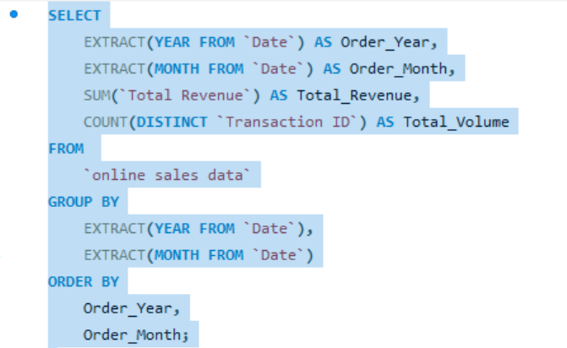
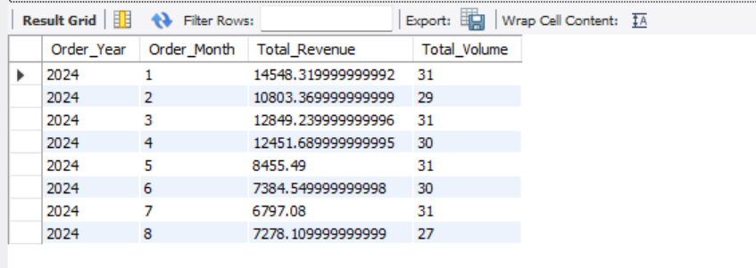
This query extracts and summarizes the total revenue and number of unique orders for each month of the year 2024 from the online sales data table.
Key Features:
Extracts year and month from the Date column
Calculates:
SUM(Total Revenue) → Total revenue per month
COUNT(DISTINCT Transaction ID) → Order volume per month
Filters data to include only rows from 2024

Slide 3
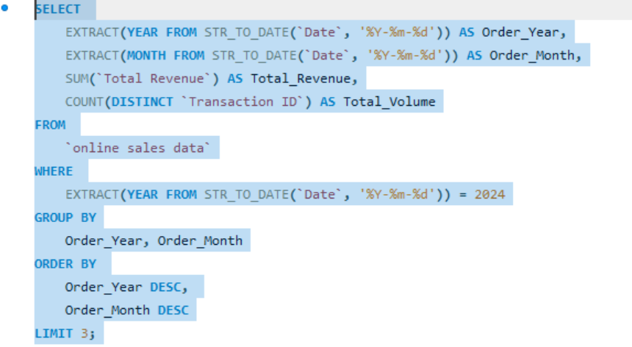
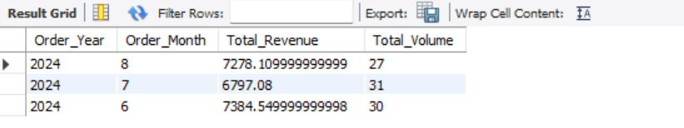
This query provides a snapshot of the most recent 3 months of sales activity in 2024, showing total revenue and order volume.
Key Features:
Same logic as above for extracting, summing, and counting
Uses LIMIT 3 to show only the latest 3 months (descending order)
Useful for tracking recent sales trends or building a dashboard KPI panel

